Slide 1
ParseAndC – A Universal Parser and Data Visualizer for C
Parbati Kumar Manna
Security Researcher, Connectivity Group Red Team,
Network and Edge (NEX) Group, Intel Corporation
#BHUSA @BLACKHATEVENTS

Slide 2
Agenda
About myself
Introduction to parsing and motivation for a universal parser
Why manual parsing is extremely hard
Three different ways to write a parser
The challenges with the User Interface
The tool demo

Slide 3

About Myself
B.Tech. from Indian Institute of Technology, Kharagpur
M.S / Ph.D. from University of Florida
Dissertation on smart viruses and worms
Working at Intel since 2008
Led security evaluation teams for various flagship Intel products
(Atom core, Chipset, Big core, Xeon Phi, Graphics etc.)
Currently security researcher at Connectivity Group Red Team
Interest in SW security, HW security, Network security
Also a musician, playwright, poet and stand-up comedian

Slide 4
What is Parsing?
Data
Data Offset
value
Data Format
Field #1 = Value#1
Field #2 = Value#2
Field #3 = Value#3
Field #4 = Value#4
Data Values
Field#1 | Field#2 | Field#3 | Field#4
n₁ bytes | n₂ bytes | n₃ bytes | n₄ bytes

Slide 5
Who Does Parsing? Why Create this Tool?
Pretty much all validators and testers (security or non-security)
Dedicated Parsers for dedicated applications
Two main parts: Essentially, repeat these two parts until no more data left to parse
Dumb data parser: Given the data format for current data, calculate the value of the various fields
Smart data interpreter: Make sense of the various fields, choose next data format for next data chunk
Advantage: Great for a specific application (uses application-specific knowledge)
Disadvantage: Useless for other applications
The need for a universal parser
The dumb data parser part is common to ALL dedicated parsers, why not keep just that?
Disadvantage: Uses ZERO application-specific knowledge, expects user to know it
Advantage: Works for ALL applications, as long as it can handle any input data format
Reverse Engineering
NW traffic analyzing
packet processing
Protocol parsing
Web applications
Mail analysis

Slide 6
ParseAndC: The Universal Parser
You feed data and data format, it does the parsing, you make sense of the data
Everything is self-contained into a single Python (.py) file of size approx. 800KB
Works for all versions of Python (2.x, 3.x, …)
Cross-Platform (Windows, Linux, Mac), GUI/Terminal/Batch
Nearly ZERO dependency on other tools (or modules):
Uses only lists, dictionaries, and regular expressions
Tcl/Tk for GUI (writing a fresh GUI library was too cumbersome)
Wrote our own compiler rather than using existing ones (LLVM etc.)
Why not re-use existing tools (lex/yacc/bison), including the compiler?
A tool might break when the modules it depend on change
Even tools/languages with wide adoptions do this all the time
Python 2.x→3.x change broke many applications

Slide 7
Why is it a big deal?
Is it that hard to write a parser?
Heck, I can even do it by hand!

Slide 8
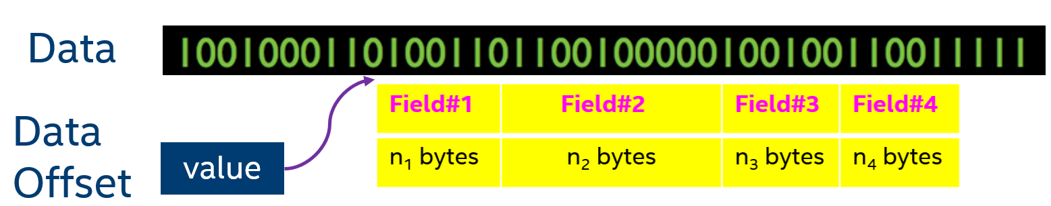

The Curse of Parse – Can I Parse Manually?
A common misconception regarding parsing
Difficulty of Parsing comes from the complexity of the source format
Given the structure containing a certain field, How do we get its value?
Calculate its location (offset) and size
Calculate its value as per its format
A Parser extracts fields values from a bitstream and shows their values
We have the source code
Format (field structure) is known
Offset = ∑ (size) of all previous fields
(also given by offsetof() macro)
We know the target field’s format
It’s not too hard to do it manually, right?

Slide 9

How Easy is it to Hand-Calculate the Field Offset?
Even ignoring the compiler-generated padding, can you calculate the offset of the payloadAddress field?
struct structHeader {
char headerName[100];
int version[2];
float weight;
char key[1024];
char ifHashed;
int hashSize;
int hashValue[32];
long encryptAlgoIndex;
char encryptAlgoName[40];
void * (*encryptFunc)(char *);
int headerLength;
int numPayloads;
char * payloadAddress;
} header1;

Slide 10
How Easy is it to Hand-Calculate the Field Offset?
Even ignoring the compiler-generated padding, can you calculate the offset of the payloadAddress field?
struct structHeader {
char headerName[HDR_LEN];
int version[2];
float weight;
char key[KEY_LEN];
char ifHashed;
int hashSize;
int hashValue[HASHVAL_LEN];
long encryptAlgoIndex;
char encryptAlgoName[40];
void * (*encryptFunc)(char *);
int headerLength;
int numPayloads;
char * payloadAddress;
} header1;
#define HDR_LEN 100
#define KEY_LEN 1024
#define HASHVAL_LEN 32

Slide 11
How Easy is it to Hand-Calculate the Field Offset?
Even ignoring the compiler-generated padding, can you calculate the offset of the payloadAddress field?
struct structHeader {
char headerName[HDR_LEN & HDR_MASK];
int version[2];
float weight;
char key[KEY_LEN & KEY_MASK+OFFVAL];
char ifHashed;
int hashSize;
int hashValue[HASHVAL_LEN];
long encryptAlgoIndex;
char encryptAlgoName[40];
void * (*encryptFunc)(char *);
int headerLength;
int numPayloads;
char * payloadAddress;
} header1;
#define macro1(a) ((a)+((a)<<10))
#define HDR_LEN 100
#define KEY_LEN 1024
#define HASHVAL_LEN 32
#define HDR_MASK 0xFF12CA
#define OFFVAL macro1(KEY_LEN)

Slide 12
How Easy is it to Hand-Calculate the Field Offset?
Even ignoring the compiler-generated padding, can you calculate the offset of the payloadAddress field?
struct structHeader {
char headerName[HDR_LEN & HDR_MASK];
int version[2];
float weight[sizeof(macroGen(9))];
char key[KEY_LEN & KEY_MASK+OFFVAL];
char ifHashed;
int hashSize[sizeof (structPtr->unionVar.A)];
int hashValue[HASHVAL_LEN];
long encryptAlgoIndex;
char encryptAlgoName[40];
void * (*encryptFunc)(char *);
int headerLength;
int numPayloads;
char * payloadAddress;
} header1;
#define macro1(a) ((a)+(a)^10)
#define macroGen(bit) bitnum##bit
#define HDR_LEN 100
#define KEY_LEN 1024
#define HASHVAL_LEN 32
#define HDR_MASK 0xFF12CA
#define OFFVAL macro1(KEY_LEN)
struct SH * structPtr;

Slide 13

Conclusion: It’s NOT Easy to Find the Offset of a Field
A data field’s offset is right after the sum of the sizes of all previous fields
Size calculation is easy for non-array elements
Datatype char – 1, short – 2, int / float – 4, double / long long - 8
Array dimensions can be complicated expressions
Arithmetic expression ( int array1[VALUE & MASK] )
Macro invocations (float array2 [custom_macro_function(some_value##bitnum)] )
Compile-time functions (double array3 [sizeof (someStrucPtr->unionVar.A)] )
Recursive nature of data declaration (struct within struct, macro within macro)
Size calculation not trivial for struct / union (padding, bit boundary etc.)
Nearly impossible to hand-calculate offsets correctly and quickly for fields part of large, complicated structures

Slide 14
We Got the Location and Size! Now What?
Can you calculate the value of a field from the raw bytes manually?

Slide 15
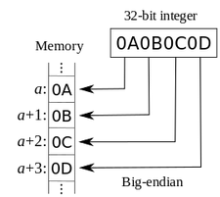
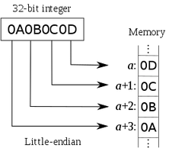
Calculate the Internal Stored Value
Computers store the bytestream differently for multi-byte values
Byte order dependent on Architecture
x86, most ARM/MIPS are Little-Endian
SPARC, IBM PowerPC, Mainframes are Big-Endian
Some architectures are bi-endian, some were mixed-endian and middle-endian
Byte order dependent on usage (Host / Network)
Host order: Usually Little-endian (0xBEEF value stored as 0xEFBE)
Network order: Always Big-endian (0xBEEF value stored as 0xBEEF)
There is no marker indicating the Endianness
The user needs to know it to make sense

Slide 16
How Easy is it to Hand-Calculate the Stored Value?
Assumption: The correct byte order is known
Unsigned data (unsigned- char, short, int, long, long long)
Easy to hand-compute the value. ASCII if char, Hex if single-byte integer
Signed data (char, short, int, long, long long)
Involves 2’s complement calculations. Slightly hard to hand-compute the value
Both Signed and Unsigned data can be only few bits wide
Need to convert to binary and then shifting. Hard to hand-compute the value
Floating-point or Double-Precision data (float, double)
Involves conversion to binary, shifting, then multiplying or dividing the Mantissa by large number. Nearly impossible to hand-compute correctly and quickly.
Conclusion: Computers over Hand-computation for value calculation

Slide 17
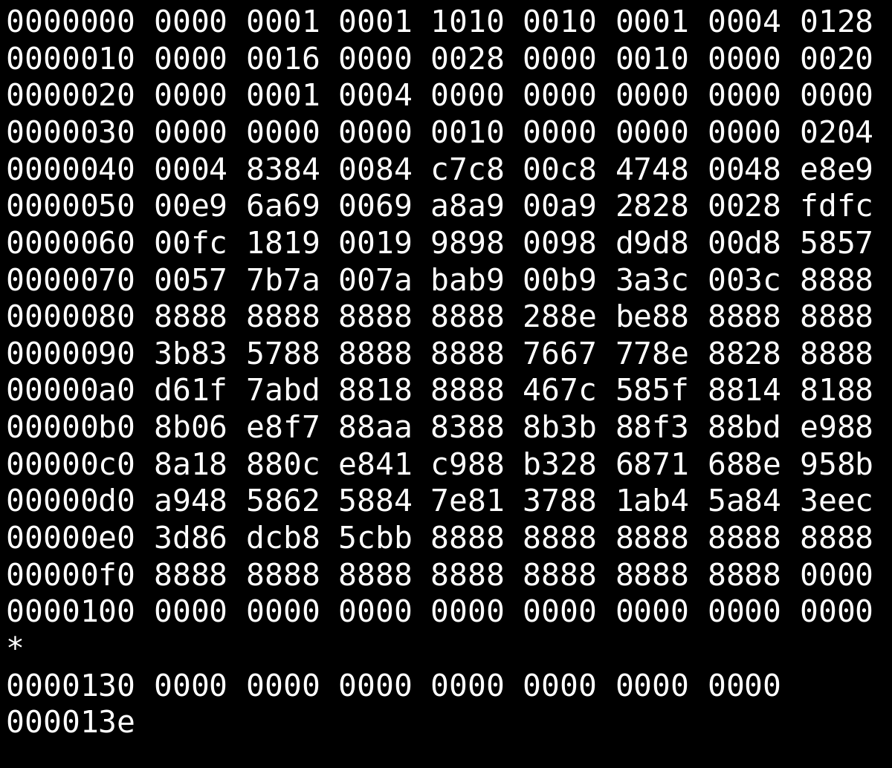
Extract ALL Field Values from ALL Structures
We can do this by writing a custom parser for each structure, right?
Struct4
Struct1
Struct2
Struct5
Struct3
Struct6
Assumption: The correct field structures and correct byte orders are known

Slide 18
How to Write a Generic Parser
A parser has two parts:
Reading in the data into that structure, and
Printing the target fields’ values.
Only one of them can be automated reliably, but not both (usually)
Easy Read? Manual print statements
Easy Print? Manual reading
Let’s look at some examples to see why

Slide 19
Option 1: Easy Read, Manual Print
struct struct1 {
char headerName[50];
long version[VNUM];
float weight;
void * (*encryptFunc)(char *);
int year;
} H1;
struct struct2 {
int data[TABLES][ROWS][COLS];
double training [NUM_TRN];
char * fileName;
} H2;
// Reading is easy, content of struct immaterial
int readStatus = fread(&H1,sizeof(H1),1,infile);
// Printing is NOT easy, content of struct matters
printf(“\nheaderName = %s”, H1.headerName);
for (int i=0; i< VNUM; i++)
printf (“\nversion[%d] = %ld”,i, H1.version[i]);
printf (“\nweight = %10.3f”,H1.weight);
printf (“\nencryptFunc = %p”,H1. encryptFunc);
Printf(“\nyear = %d”,H1.year);
// Reading is easy, content of struct immaterial
int readStatus = fread(&H2,sizeof(H2),1,infile);
// Printing is NOT easy, content of struct matters
for (int i=0; i< TABLES; i++)
for (int j=0; j< ROWS; j++)
for (int k=0; k< COLS; j++)
printf (“\ndata[%d][%d][%d] = %d”,i,j,k,H2[i][j][k]);
for (int i=0; i< NUM_TRN; i++)
printf (“\n training[%d] = %f”,i, H2.training [i]);
printf (“\nfileName = %s”,H2.fileName);

Slide 20
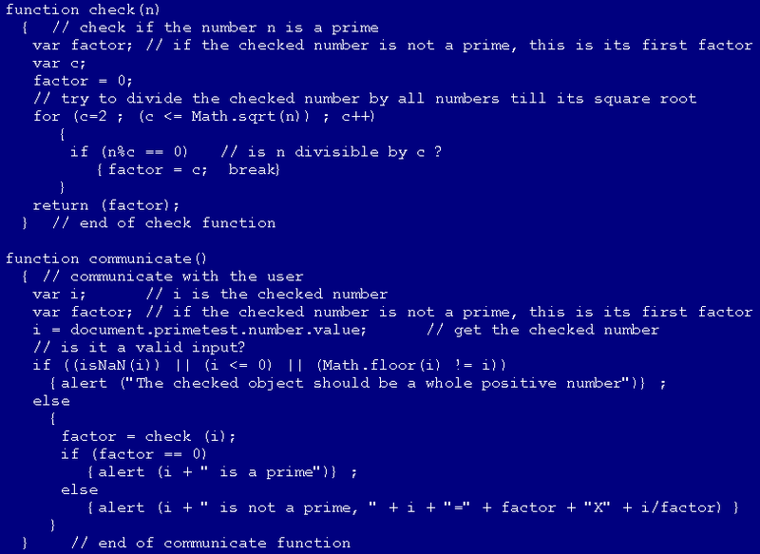
Option 1: Unmodified Input to Variable Parser
Assumption: The correct field structure and byte orders is known
Method: Write a Parser with the correct field structure hardcoded
The field structure is NOT fed as input to this parser, it is already part of it
Advantage:
Reading is concise (just 1 statement)
Reading is 100% reliable
Disadvantage:
Printing is manual, must hardcode individual print statement for each of the fields
Need to write new program, compile and run every time the input structure changes
Conclusion:
Unsuitable for parsing many structures, since manual printing is error-prone
Variable Parser (extremely simple, but tedious)
Input file structure
A =1
B = 10
C = “Hi”
D = 3.14
Input file
Output

Slide 21
Option 2: Manual Read, Easy Print
struct struct1 {
char headerName[50];
long version[VNUM];
float weight;
void * (*encryptFunc)(char *);
int year;
} H1;
Use Intermediate Representation of Structure
struct struct2 {
int data[TABLES][ROWS][COLS];
double trainingValues[NUM_TRN];
char * fileName;
} H2;
Name | Type | Array size
data | Int | TABLES x ROWS x COLS
trainingValues | Double | NUM_TRN
filename | Pointer | 1
Name | Type | Array size
headerName | Char | 50
version | Long | VNUM
weight | Float | 1
encryptFunc | Pointer | 1
year | Int | 1
// Simple Parser code
For each line in Intermediate Representation
For each array element
Read the field from the bytestream
Print the field appropriately

Slide 22

Option 2: Modified Structure as Input to Fixed Parser
Method: Write a fixed Parser that reads an input structure in a fixed, predefined format
Hand-convert the field Structure into Testing program’s predefined format
Advantage:
No need to hardcode individual print statement for each of the fields read
No need to write/compile new program every time the input structure changes
Disadvantage:
Every time field structure changes, need to hand-convert it to the Parser’s format
Unreliable parsing (reading) as hand-conversion might be erroneous
Conclusion:
Not suitable where we need to examine many parts of the same bytestream with different structures, and need reliable output
ConvertedInput file structure in fixed format
A =1
B = 10
C = “Hi”
D = 3.14
Fixed Parser
(simple)
Input file
Output

Slide 23
Option 3: Unmodified Structure Input to a Fixed Parser
Method: Write a fixed Parser that reads the unmodified structure as its input
It understands the underlying format, and displays the field values accordingly
Advantage:
No manual Read per field (no hand-converting anything) – just run with the proper input
No manual Print per field (no need to hardcode individual print statement for each field)
No need to write/compile new program every time the input structure changes
Disadvantage:
A parser that can understand a programing language is essentially a compiler
Conclusion:
Suitable where we need to examine many bytestreams with different structures, and need reliable output (but will need to write the compiler)
Input file structure
A =1
B = 10
C = “Hi”
D = 3.14
Fixed Parser
(Extremely Complex)
Input file
Output

Slide 24
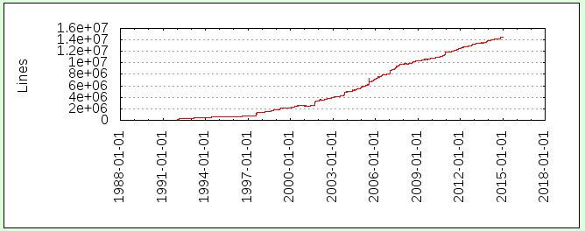

Come on, Writing a Compiler can’t be THAT Hard!!
Steps for writing a compiler:
Lexical Analysis
Syntactic analysis
Operator Precedence
Abstract Syntax Tree
Preprocessing
Interpretations
…. And much more
Size of gcc
How big is the code base of a full-fledged compiler, anyway?

Slide 25
OK, Wrote the Compiler! Now How do I show the Data?
We want to show the parsed data against the input structure
Compiled code structure may look completely different
with compile-time constants and macros resolved
How do we know if the compiler interpreted the variable declaration correctly?
Need a way to communicate how it interpreted the data
One-to-Many relationship between code and data:
An array item like int var[20][30][50] will generate 30,000 int objects
Many-to-One relationship between code and data:
All Union members will point to the same data item
Byte-Order: What value to show? Little-endian or Big-endian?

Slide 26
ParseAndC: Different from Other “Regular” Tools
Observations:
Testers do not like alterations of their workflow
Must have extremely simple methods of Download, Installation, and Updation
Not every C developer/tester knows Python
Just works and never breaks
Goals:
Maximize deployment
Avoid writing “smart” code; comment extensively
Coding style more C-style than “Pythonic”
Ubiquitous and simple debuggability
Must be self-contained and work everywhere

Slide 27
ParseAndC: The Visual Parser for C Structures
Supports C structures (dominant language for system-level programming)
Input:
C structure file (or hand-code)
Target binary file
Starting offset of data (optional, default is 0)
Output:
Interpreted code, with compile-time constants and macros resolved
Interpreted data, with visual clues of what data represents what field, and their values (in all possible byte-orders)
Demo time!
Tool: https://github.com/intel/ParseAndC

Slide 28
ParseAndC: Key Takeaways
ParseAndC is ONE tool that allows you to parse ALL applications (You would never have to write another custom parser)
It “just works” everywhere, fully cross-platform, never breaks
Equally valuable for security- and non-security testers, White Hat and Black Hat hackers

Slide 29

ParseAndC: Questions and Answers

Slide 30


ParseAndC: Thank You

